Slide 1
Diagnosing Breast Cancer
Breast Cancer Wisconsin Data Set

Slide 2
Outline
Breast Cancer – Background Info
Data Set overview
Exploratory Analysis
Overfitting?
The different models
Logistic Regression
KNN
Decision Tree
Conclusion
Next Steps

Slide 3

Background Information – Breast Cancer
Abnormal cell growth → tumor
Malignant cancer cells form in breast tissue
1 in 8 women in the US will be diagnosed with breast cancer
Each year 246,660 women in the US will receive the diagnosis
40,000 women will die from breast cancer each year
Detection
Mammogram (X-ray to look at the breast tissue)
Breast biopsy – removing cells from the abnormal growth of tissues to see if it malignant→ fine needle aspirate (FNA) of a breast mass

Slide 4
Problem Statement & Significance
Goal: predicting if the abnormal breast tissue cells from the biopsy are benign or malignant cancer cells.
Why?
Improving the accuracy and efficiency of the diagnosis
Through understanding the process and the features that indicate if the tumor is benign or malignant could help in treatment research
Notes:
Goal: using the UCI dataset on the features of the cells taken from biopsy I wanted to predict if the cancer cells are benign or malignant

Slide 5
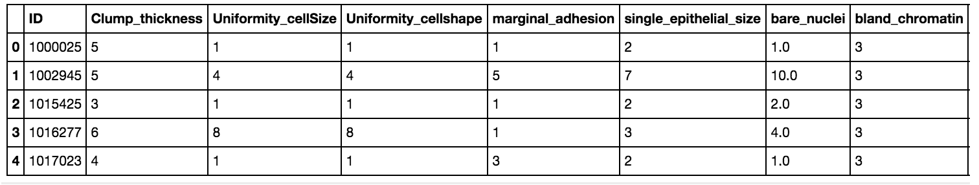
The Data Set
Location = r'/Users/Carlina/Documents/DataScience/DAT-NYC-37-master/DAT-NYC-37/projects/final-projects/Dataset/breast-cancer-wisconsin.csv'df = pd.read_csv(Location)
df.head(5)
Number of Instances: 699 (as of 15 July 1992)
Notes:
- University of Wisconsin Hospitals, Madison from Dr. William H. Wolberg

Slide 6
Data Set Variables
1. Sample code number: id number 2. Clump Thickness: 1 - 10 3. Uniformity of Cell Size: 1 - 10 4. Uniformity of Cell Shape: 1 - 10 5. Marginal Adhesion: 1 - 10 6. Single Epithelial Cell Size: 1 - 10 7. Bare Nuclei: 1 - 10 8. Bland Chromatin: 1 - 10 9. Normal Nucleoli: 1 - 10 10. Mitoses: 1 - 10 11. Class: (2 for benign, 4 for malignant)

Slide 7
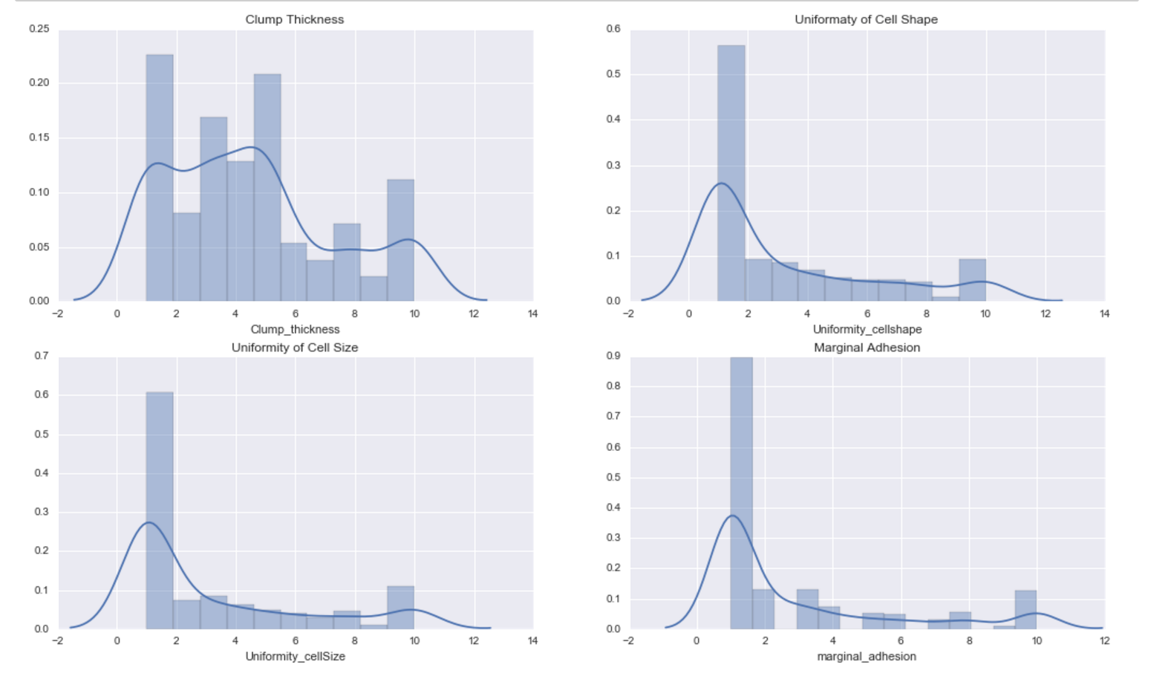
Exploratory Analysis
Notes:
Benign: 458 (65.5%) Malignant: 241 (34.5%)

Slide 8
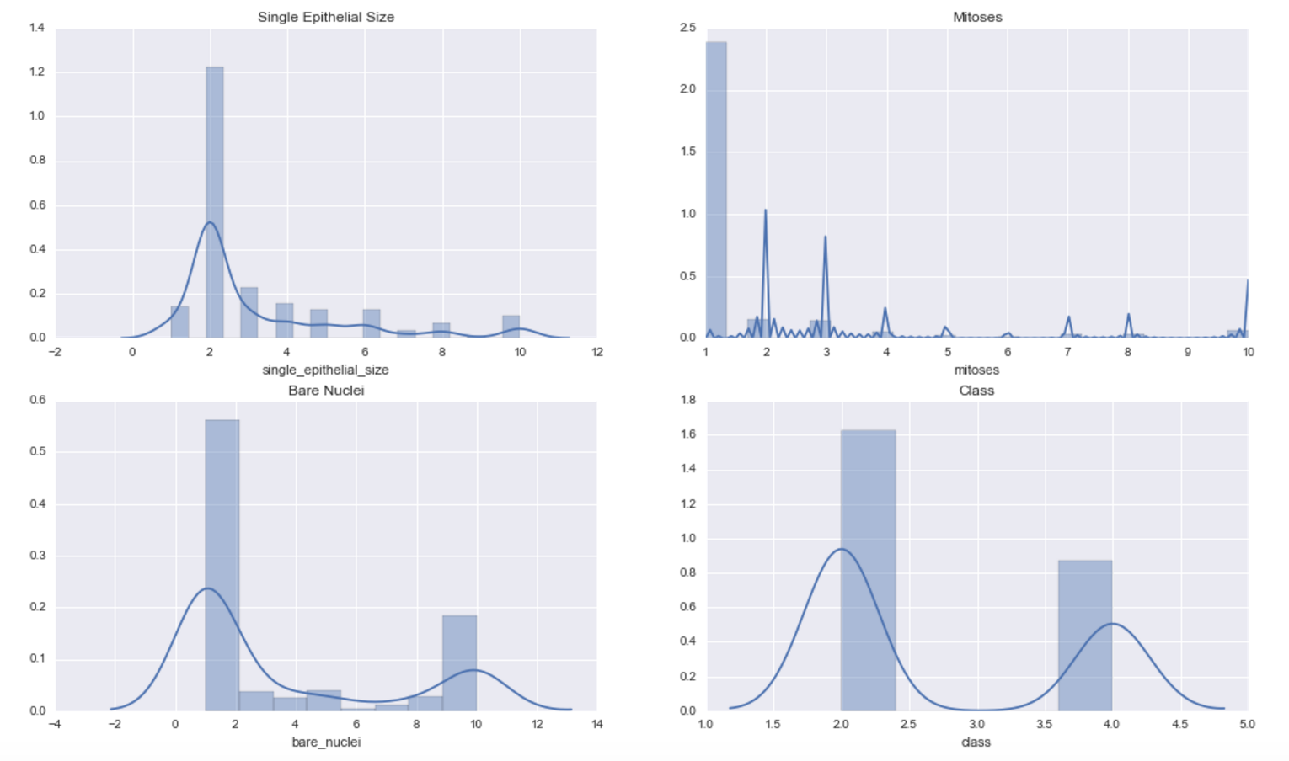
Exploratory Analysis
Notes:
Benign: 458 (65.5%) Malignant: 241 (34.5%)

Slide 9
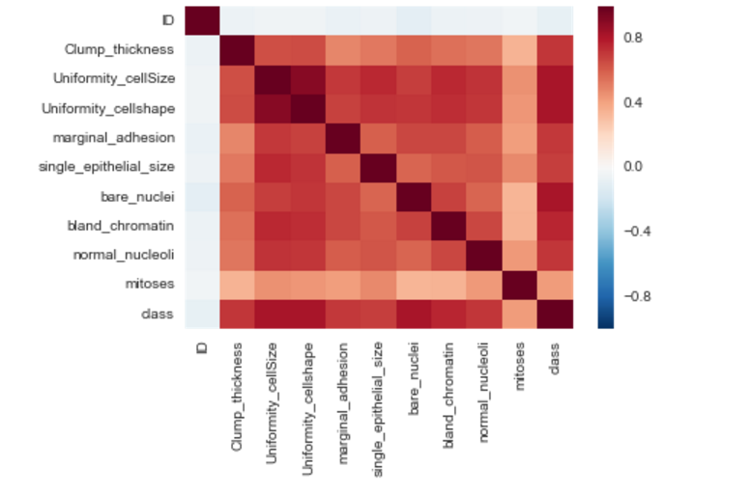
Exploratory Analysis
Notes:
High correlation between the variables --> overfitting

Slide 10
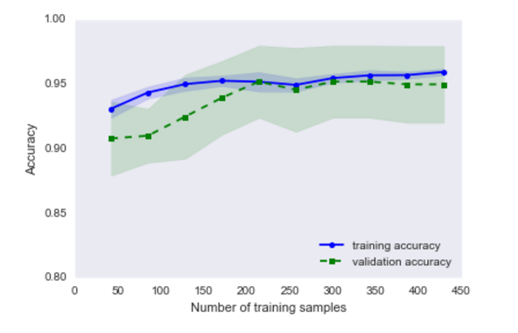
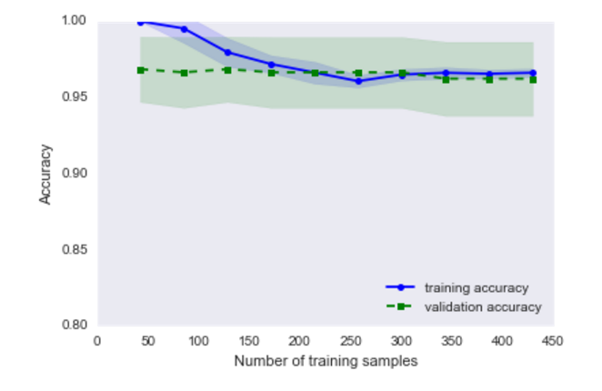
Logistic Regression – Overfitting?
Before PCA
After PCA
Notes:
#learning curve plot, to see if the model has too high variange or high bias, and if collecting more data would help improve the model
it shows the model is slightly overfitting, (gap at the beginning between training and validation accuracy)
PCA = principal component analysis → PCA aims to find the directions of maximum variance in high-dimensional data and projects it onto a new subspace with equal or fewer dimensions that the original one. → puts everything on the same scale so that there are less dimensions

Slide 11
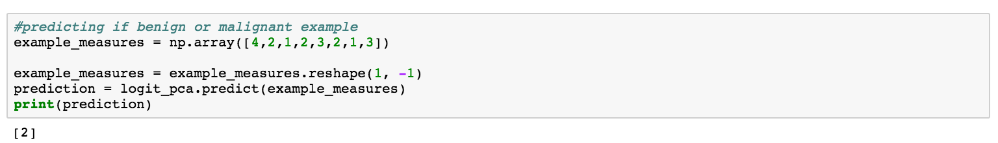
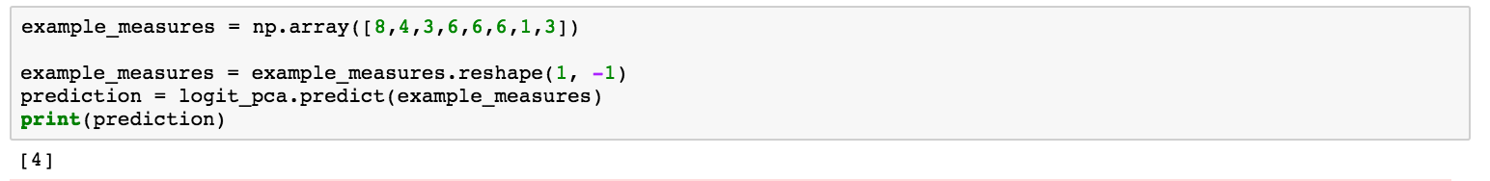
Logistic Regression
Creating the Logistic Regression Model:
Using the classifier for predictions:
Benign
Malignant

Slide 12
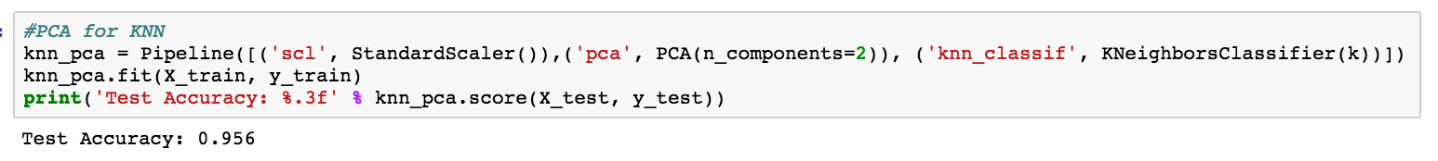
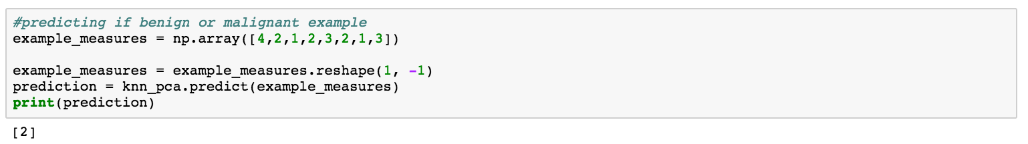
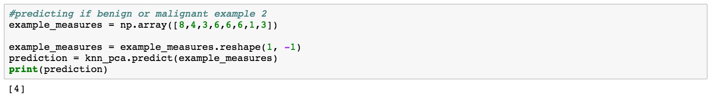
KNN
Creating the KNN Classifier:
Using the classifier for predictions:
Benign
Malignant

Slide 13
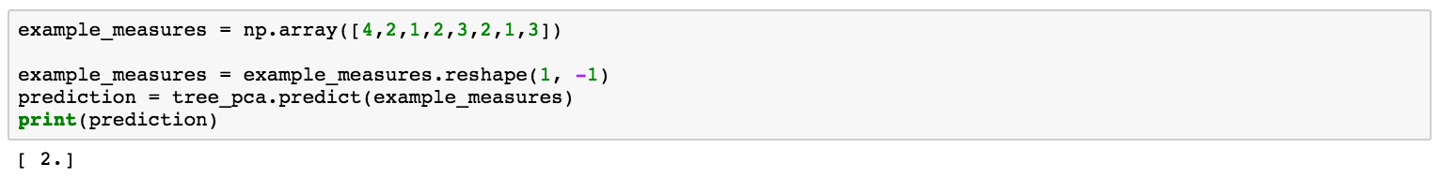
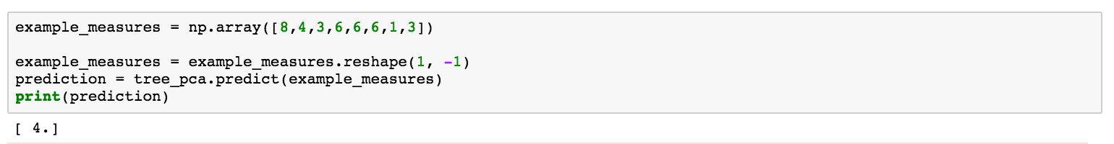
Decision Trees
Creating the Decision Tree Model:
Using the classifier for predictions:
Benign
Malignant

Slide 14
Conclusion
After PCA was applied to all of the conditions, highest accuracy score with Logistic Regression Model
KNN | Decision Trees | Logistic Regression
+ dead simple | + fast | + fast & scales moderately well w/ large # of features
+ lazy learner —> very fast to train | + categorical | + simple to apply and interpret
+ nonlinear classifier | - tendency to overfit | + yields log likely function - > % likelihood of a given outcome
- can be slow to test |  | - doesn’t handle complexity
- doesn’t handle large feature space well

Slide 15
Next Steps
AUC score and F1 Score
B/c the target class is unbalanced
UCI also has two other data sets (prognostic and diagnostic)
Involves different features focused on the cell nuclei and info on follow up patients
More recent data sets – to see if this data is outdated
B/c the data set is from 1992
Additional features? Have biopsy methods changed? Genetic factors?

